Slide 1


CAPSTONE PROJECT DEFENSE | BACHELOR OF SCIENCE IN INFORMATION TECHNOLOGY
RESEARCH TITLE
WEB-BASED QR ENABLED PET REGISTRATION, VACCINATION AND TRACEABILITY MANAGEMENT SYSTEM WITH PAYMENT MONITORING AND DATA ANALYTICS FOR THE CITY VETERINARY ANIMAL CLINIC IN CABUYAO CITY, LAGUNA.
Group 15 BSIT-B | College of Computing Studies
Pamantasan ng Cabuyao, City of Cabuyao, Laguna
RESEARCHERS:
Trinidad, Kaizen Brix
Catalonia, Zyrus M.
Ocharan, Mark Lawrecnce C.
Parala, Andrei Vincent S.
ADVISER:
ASST. Prof. Melissa A. Dimaculangan
Notes:
Greet the panel. Introduce the title, the group and each researcher, and the adviser. About 20 seconds.

Slide 2
RATIONALE
Why we conducted this research
Background
Problems at the clinic
Research Gap
The clinic manages owner and pet registration, vaccination, and payment records
Records are still mostly manual - prone to delays, inconsistencies, and difficult data access
Matching Treasury-issued Official Receipts with payments is hard to trace
Manual and fragmented registration with long waiting lines
Difficulty tracing which clients have paid and which have not
Poor vaccination tracking and weak analytics for planning
Existing systems lack an integrated registration, QR traceability, payment, and analytics platform
No single scannable identifier linking a pet's registration, vaccination, payment, and clinical records
A web-based system built for the City Veterinary Animal Clinic is needed
WEB-BASED QR-ENABLED PET REGISTRATION, VACCINATION, AND TRACEABILITY SYSTEM WITH PAYMENT MONITORING AND DATA ANALYTICS City Veterinary Animal Clinic, Cabuyao City, Laguna
Notes:
Start with the background, then the problems we saw at Bigaa Elementary School, then the gap: generic platforms are not accessible enough for SNED learners. About 1 minute.

Slide 3
OBJECTIVES
What we set out to do
General objective: Implement and document an integrated web-based system - the Web-Based QR-Enabled Pet Registration, Vaccination, and Traceability Management System with Payment Monitoring and Data Analytics - for the City Veterinary Animal Clinic of Cabuyao City, Laguna.
OBJECTIVE 1
OBJECTIVE 2
OBJECTIVE 3
Develop and implement
Implement a centralized online system
Evaluation
Role-based access for Admin, Staff, Veterinarian, and Pet Owner
Owner and pet registration, a unique QR code per pet, and a digital pet booklet
Vaccination monitoring and a multi-step consultation workflow with medicine prescription
Treasury-issued Official Receipt monitoring and offline draft registration
ISO/IEC 25010 Software Quality Model
End users: Functional Suitability, Performance Efficiency, Usability
IT experts: Reliability and Security
Unified database linking owner, pet, payment, vaccination, clinical, and medicine records
Role-specific dashboards and workflows for each system role
QR scanning, search and filter functions
Data analytics and reporting with activity auditing
Notes:
Read the general objective in your own words, then the three specific objectives. Tell the panel that the results later are presented objective by objective. About 40 seconds.

Slide 4
SCOPE AND LIMITATIONS
What the study covers, and where it stops
Scope
Limitations
City Veterinary Animal Clinic of Cabuyao City, Laguna only
Role-based access for Admin, Staff, Veterinarian, and Pet Owner
Owner and pet registration, QR code generation, and a digital pet booklet
Vaccination monitoring; clinical and medicine records; payment monitoring via Official Receipts
Analytics and reporting, notifications, outreach, activity audit, and offline drafts
Results cannot be generalized to other clinics or institutions
Web-based only; no native Android or iOS application
No pharmacy, inventory, lab testing, confinement, or surgery management
No full appointment scheduling; offline drafts are device-local with no live sync
No direct Treasury integration; Official Receipts are recorded manually
WEB-BASED QR ENABLED PET REGISTRATION, VACCINATION AND TRACEABILITY MANAGEMENT SYSTEM WITH PAYMENT MONITORING AND DATA ANALYTICS FOR THE CITY VETERINARY ANIMAL CLINIC IN CABUYAO CITY, LAGUNA.
Notes:
Scope on the left, limitations on the right. Stress that it is one school, one program, and only the research period. About 45 seconds.

Slide 5
METHODOLOGY
Developmental research design (Agile Scrum)
Two phases
Respondents by group (N = 55)
Pre-development (qualitative): interview, consultation, and observation at the clinic
Development: Agile Scrum in iterative sprints with a working increment each sprint
Post-development (quantitative): ISO/IEC 25010 evaluation questionnaires (five-point Likert scale)
Unit testing (17 of 17 passed) and integration testing (8 of 8 passed)
Respondents: 55 purposely selected - 50 end users and 5 IT experts
WEB-BASED QR-ENABLED PET REGISTRATION, VACCINATION, AND TRACEABILITY SYSTEM
WITH PAYMENT MONITORING AND DATA ANALYTICS | City Veterinary Animal Clinic, Cabuyao City, Laguna
Notes:
Explain the two phases: we studied the problem first, then built and evaluated the system. Mention the 62 respondents and that the evaluation followed a one-week UAT. About 1 minute.

Slide 6
EVIDENCE OF METHODOLOGY
Agile Scrum: every sprint was carried out
SPRINT 0
SPRINT 1
SPRINT 2
SPRINT 3
Requirements
Login and foundation
Registration and QR codes
Vaccination and payments
Interviews, consultations, observation, and document analysis; user stories and product backlog
Account management, role-based login, React, Node.js, and MySQL/Supabase set up
Owner and pet registration; unique QR code per registered pet and a digital pet booklet
Vaccination history recording and monitoring; payment monitoring with Treasury Official Receipts
SPRINT 4
SPRINT 5
SPRINT 6
SCRUM EVENTS
Clinical and medicine
Analytics and admin
Testing and UAT
Sprint planning
Daily scrum
Sprint review with stakeholders
Sprint retrospective
Multi-step consultation workflow; medicine prescription with auto-computed dosage
Analytics dashboards and reporting; activity audit, product catalog, and announcements
Unit and integration testing; ISO/IEC 25010 evaluation by end users and IT experts
WEB-BASED QR-ENABLED PET REGISTRATION, VACCINATION, AND TRACEABILITY SYSTEM
WITH PAYMENT MONITORING AND DATA ANALYTICS | City Veterinary Animal Clinic, Cabuyao City, Laguna
Notes:
This slide is our proof that we followed Agile Scrum. Walk through the sprints quickly: requirements first, then login, lessons, assessments, progress and communication, accessibility, and finally testing and UAT. About 50 seconds.

Slide 7
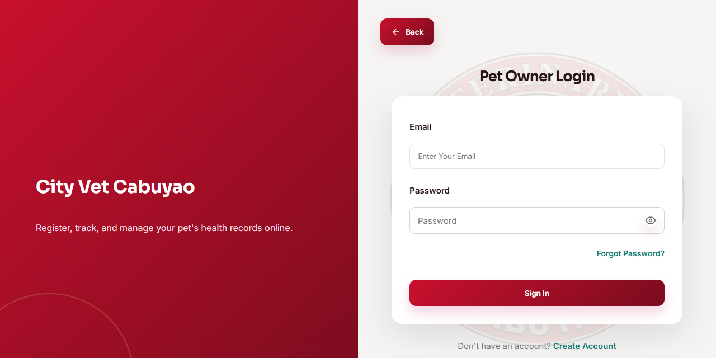
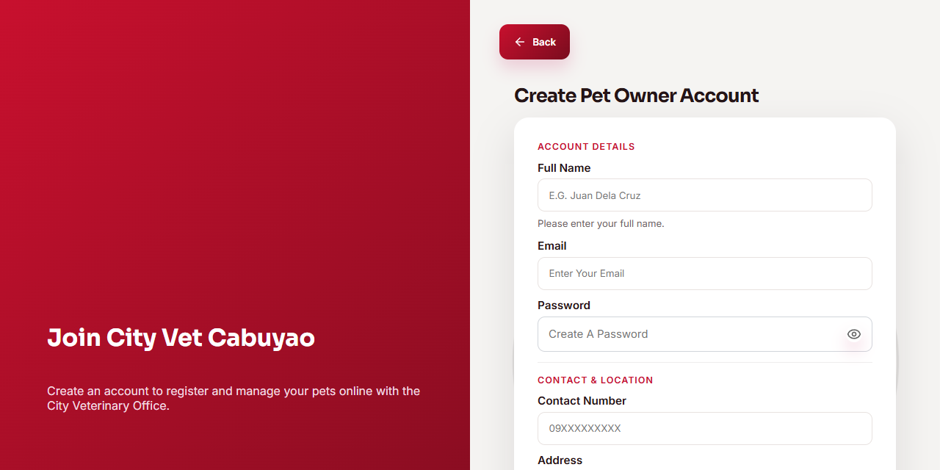
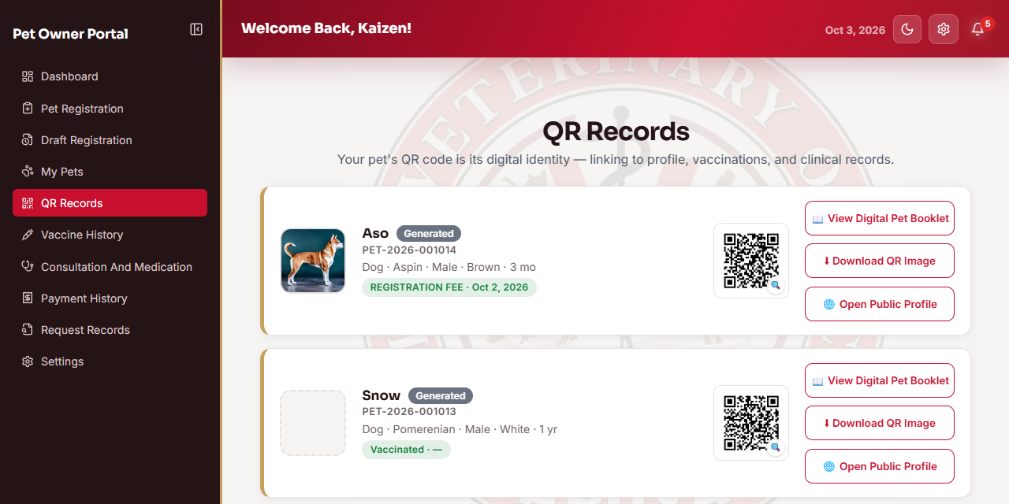
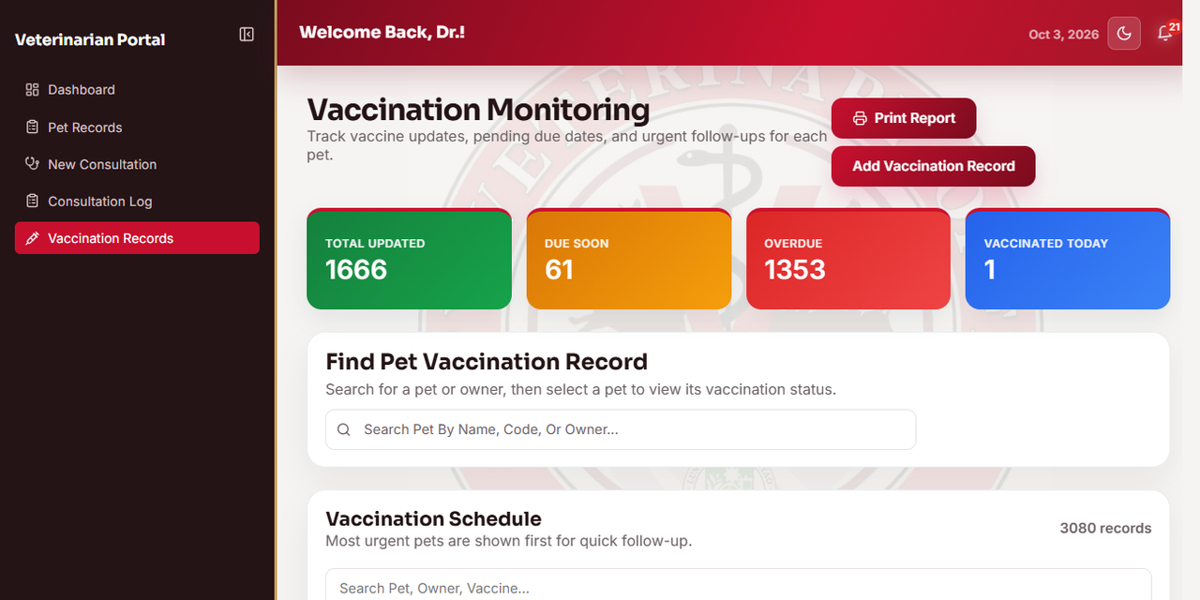
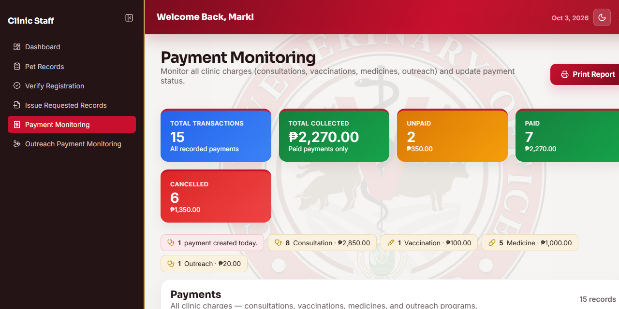
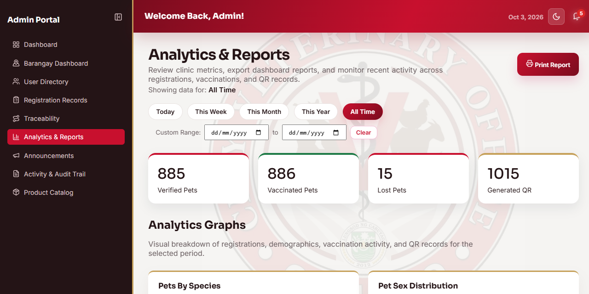
EVIDENCE OF METHODOLOGY
Working system outputs from the sprints
Sprint 1 | Role-based login and portal
Sprint 2 | Owner and pet registration
Sprint 2 | Unique QR code per pet
Sprint 3 | Vaccination monitoring
Sprint 4 | Payment monitoring
Sprint 5 | Data analytics and reporting
WEB-BASED QR-ENABLED PET REGISTRATION, VACCINATION, AND TRACEABILITY SYSTEM
WITH PAYMENT MONITORING AND DATA ANALYTICS | City Veterinary Animal Clinic, Cabuyao City, Laguna
Notes:
Point at two or three screens as examples: the login, the student portal and the accessibility settings. These are the actual outputs of the sprints. About 40 seconds.

Slide 8
OBJECTIVE 1 | RESULTS > DISCUSSION > CONCLUSION
Develop and implement the integrated system
RESULTS
17 / 17
8 / 8
4 roles
7 modules
functions passed unit testing across 7 modules
integration scenarios passed
role-based access for Admin, Staff, Veterinarian, and Pet Owner
modules implemented - registration, QR, vaccination, payments, records, analytics
DISCUSSION
CONCLUSION
Minor defects (incomplete validation messages and minor formatting inconsistencies) were fixed within each sprint, and the affected functions were retested and passed (100%).
The system was successfully designed and implemented; every module worked individually and together as one integrated platform.
WEB-BASED QR-ENABLED PET REGISTRATION, VACCINATION, AND TRACEABILITY SYSTEM
WITH PAYMENT MONITORING AND DATA ANALYTICS | City Veterinary Animal Clinic, Cabuyao City, Laguna
Notes:
Results first: every function passed unit testing and every integration scenario passed. Then accessibility ratings from both groups. Discussion: defects were fixed within the sprint, which is how Scrum works. Conclusion: Objective 1 was met. About 55 seconds.

Slide 9
OBJECTIVE 2 | RESULTS > DISCUSSION > CONCLUSION
Centralized online system implemented
RESULTS
Implemented modules
User management and authentication
Pet registration (owner and pet)
QR code generation and traceability
Vaccination management
Payment and payment receipt monitoring
Clinical and medicine records
Data analytics and reporting
DISCUSSION
CONCLUSION
All 8 integration scenarios passed - data flows correctly across authentication, registration, QR, vaccination, notifications, consultation-to-payment, PDF booklet generation, analytics, and offline draft submission.
The centralized online system with a unified database, QR scanning, search and filter, analytics, and activity auditing was successfully implemented.
WEB-BASED QR-ENABLED PET REGISTRATION, VACCINATION, AND TRACEABILITY SYSTEM
WITH PAYMENT MONITORING AND DATA ANALYTICS | City Veterinary Animal Clinic, Cabuyao City, Laguna
Notes:
We built eight modules covering everything in Objective 2. The chart shows the highest-rated items: teachers can adjust accessibility settings (4.44) and get accurate reports (4.33); parents get timely notifications (4.20). Conclusion: Objective 2 was met. About 55 seconds.

Slide 10
OBJECTIVE 3 | RESULTS > DISCUSSION > CONCLUSION
Evaluation by Pet Owners, Clinic Staffs, and Veterinary (ISO/IEC 25010)
RESULTS (weighted mean, five-point Likert scale)
4.25
Grand weighted mean - Strongly Agree
4.28
Highest: Performance Efficiency (Strongly Agree)
DISCUSSION
CONCLUSION
N = 50 end users (clinic staff and pet owners). Lowest items were vaccination history recording (4.04) and pet information presentation (4.10) - these point to training needs, not core defects. 12 of 18 indicators scored Strongly Agree.
End users strongly agreed that the system is acceptable and serves the clinic's registration, identification, vaccination, and payment processes.
WEB-BASED QR-ENABLED PET REGISTRATION, VACCINATION, AND TRACEABILITY SYSTEM
WITH PAYMENT MONITORING AND DATA ANALYTICS | City Veterinary Animal Clinic, Cabuyao City, Laguna
Notes:
Read the chart: guardians rated satisfaction highest (4.34), teachers rated functionality highest (4.27). Grand mean is 4.19, interpreted as Agree. The lowest items were about devices and slow internet, which are outside the core system. About 55 seconds.

Slide 11
OBJECTIVE 3 | RESULTS > DISCUSSION > CONCLUSION
Evaluation by IT experts (ISO/IEC 25010:2023)
RESULTS (n = 5, weighted mean)
4.95
5.00
Overall weighted mean - Strongly Agree
Usability (Strongly Agree)
DISCUSSION
Experts (N = 5) rated every quality characteristic Strongly Agree; Performance Efficiency was lowest at 4.87. Twenty-two of thirty indicators scored a perfect 5.00.
CONCLUSION
The system is highly acceptable to technical evaluators (4.95) and to end users (4.25). The general objective was met.
WEB-BASED QR-ENABLED PET REGISTRATION, VACCINATION, AND TRACEABILITY SYSTEM
WITH PAYMENT MONITORING AND DATA ANALYTICS | City Veterinary Animal Clinic, Cabuyao City, Laguna
Notes:
Independent IT experts rated eight quality characteristics. Security and portability were highest at 4.20; function suitability was lowest at 3.95. Together with the user ratings, the study met its general objective. About 45 seconds.

Slide 12
RECOMMENDATIONS
Based on what the results showed
FINDING
FINDING
FINDING
Vaccination history recording was the lowest-rated end-user item (4.04)
Web-only access with device-local offline drafts
Payments rely on manual Official Receipt recording
RECOMMENDATION
RECOMMENDATION
RECOMMENDATION
Reinforce the vaccination module and provide training and orientation for staff and veterinarians
Develop a native mobile application and real-time synchronization across devices
Integrate an online payment gateway; notify owners of due vaccines and follow-ups via email or SMS
FINDING
FINDING
Keep the system as a daily support to the clinic, with regular backups, audits, and a contingency plan.
No medicine inventory, stock management, or custom reports yet
Study covered one clinic and one research period
RECOMMENDATION
RECOMMENDATION
Add medicine inventory and custom report generation with multiple export formats
Future studies: other clinics, long-term effects, and maintainability and portability
Notes:
Each recommendation comes from a specific finding. Slow internet and device use were the lowest items, teacher satisfaction was the lowest criterion, and function suitability was the lowest for the IT experts. The last one comes from our limitations. About 50 seconds.

Slide 13
THANK YOU
Researchers
Trinidad, Kaizen Brix A.| Catalonia, Zyrus M. | Ocharan, Mark Lawrence C. | Parala, Andrei Vincent S.
WEB-BASED QR-ENABLED PET REGISTRATION, VACCINATION, AND
TRACEABILITY MANAGEMENT SYSTEM
WITH PAYMENT MONITORING AND DATA ANALYTICS
City Veterinary Animal Clinic, Cabuyao City, Laguna
Notes:
Thank the panel and invite questions. About 10 seconds.

